Slide 1

Lecture-5

Slide 2
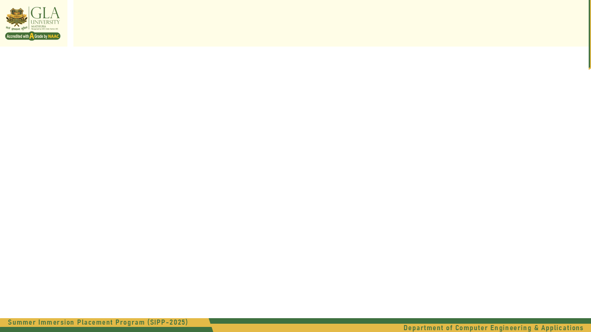
Template Literals
What Are Template Literals?
Template Literals are a modern way to work with strings in JavaScript. They were introduced in ES6 (ECMAScript 2015) and are defined using backticks (`) instead of single or double quotes.
let message = `Hello, World!`;
console.log(message);

Slide 3
Template Literals
Old Way
let profileInfo =
"<div class='card'>" +
"<h2>" + userName + "</h2>" +
"<p>Role: " + userRole + "</p>" +
"<p>Experience: " + experience + " years</p>" +
"</div>";
console.log(profileInfo);
let userName = “GLA University";
let userRole = “Full Stack";
let experience = 3;

Slide 4
Template Literals
Modern JavaScript
let profileInfo = `
<div class="card">
<h2>${userName}</h2>
<p>Role: ${userRole}</p>
<p>Experience: ${experience} years</p>
</div>
`;
console.log(profileInfo);
let userName = “GLA University";
let userRole = “Full Stack";
let experience = 3;

Slide 5
Document Object (DOM) Dynamic User Profile Card (Using ${})
<div id="Container"></div> <script> document.getElementById("Container").innerHTML = profileInfo; </script>

Slide 6
Embedding Variables
String Interpolation (Embedding Variables)
Before template literals, if you wanted to include variables in a string, you’d have to concatenate them using the + operator like this:
let name = "Abhinav";
let greeting = "Hello, " + name + "! Welcome to JavaScript.";
console.log(greeting);
With template literals, you can directly embed variables or expressions using ${} — no need for messy concatenation.
let name = "Abhinav";
let greeting = `Hello, ${name}! Welcome to JavaScript.`;
console.log(greeting);
let a = 10;
let b = 5;
console.log(`The sum of ${a} and ${b} is ${a + b}.`);

Slide 7
2. Multi-line Strings
Writing multi-line strings used to be painful before ES6. You had to use the newline character \n or string concatenation.
let oldWay = "This is line 1.\n" +
"This is line 2.\n" +
"This is line 3.";
console.log(oldWay);
With template literals
let message = `This is line 1.
This is line 2.
This is line 3.`;
console.log(message);

Slide 8
3. Expressions and Function Calls Inside Template Literals
Example 1 – Function Call:
function greet(name) {
return `Hello, ${name}!`;
}
console.log(`${greet("Abhinav")}, how are you today?`);
Example 2 – Conditional Expressions:
let marks = 85;
console.log(`You have ${marks >= 40 ? "passed" : "failed"} the exam.`);

Slide 9
4. Nesting Template Literals
Useful when building dynamic content or HTML templates.
let product = "Laptop";
let price = 75000;
let message = `The product "${product}" costs ₹${price}.
${price > 50000 ? "It's a premium item." : "It's affordable."}`;
console.log(message);

Slide 10
5. Template Literals in HTML Templates
Template literals are especially handy when generating HTML code dynamically in JavaScript.
let name = “Sam";
let age = 22;
let html = `
<div>
<h2>${name}</h2>
<p>Age: ${age}</p>
</div>
`;
console.log(html);

Slide 11
Output:
<div>
<h2>Sam</h2>
<p>Age: 22</p>
</div>

Slide 12
Feature | Using + | Using ${}
Readability | Hard | Easy
Supports expressions | Limited | Yes
Multi-line support | No | Yes
Real-world use | Outdated | Modern standard (ES6+)

